Slide 1
E-retail factors for customer activation and retention: A case study from Indian e-commerce customers
Abhishek Pai

Slide 2
Problem Statement
Customer satisfaction has emerged as one of the most important factors that guarantee the success of online store; it has been posited as a key stimulant of purchase, repurchase intentions and customer loyalty. A comprehensive review of the literature, theories and models have been carried out to propose the models for customer activation and customer retention. Five major factors that contributed to the success of an e-commerce store have been identified as: service quality, system quality, information quality, trust and net benefit. The research furthermore investigated the factors that influence the online customers repeat purchase intention. The combination of both utilitarian value and hedonistic values are needed to affect the repeat purchase intention (loyalty) positively. The data is collected from the Indian online shoppers. Results indicate the e-retail success factors, which are very much critical for customer satisfaction.

Slide 3
Business Goal
To apply analytical skills to give findings and conclusions in detailed data analysis written in Jupiter notebook

Slide 4
Steps
Loading dataset
Performing analysis
Providing observation and conclusion

Slide 5
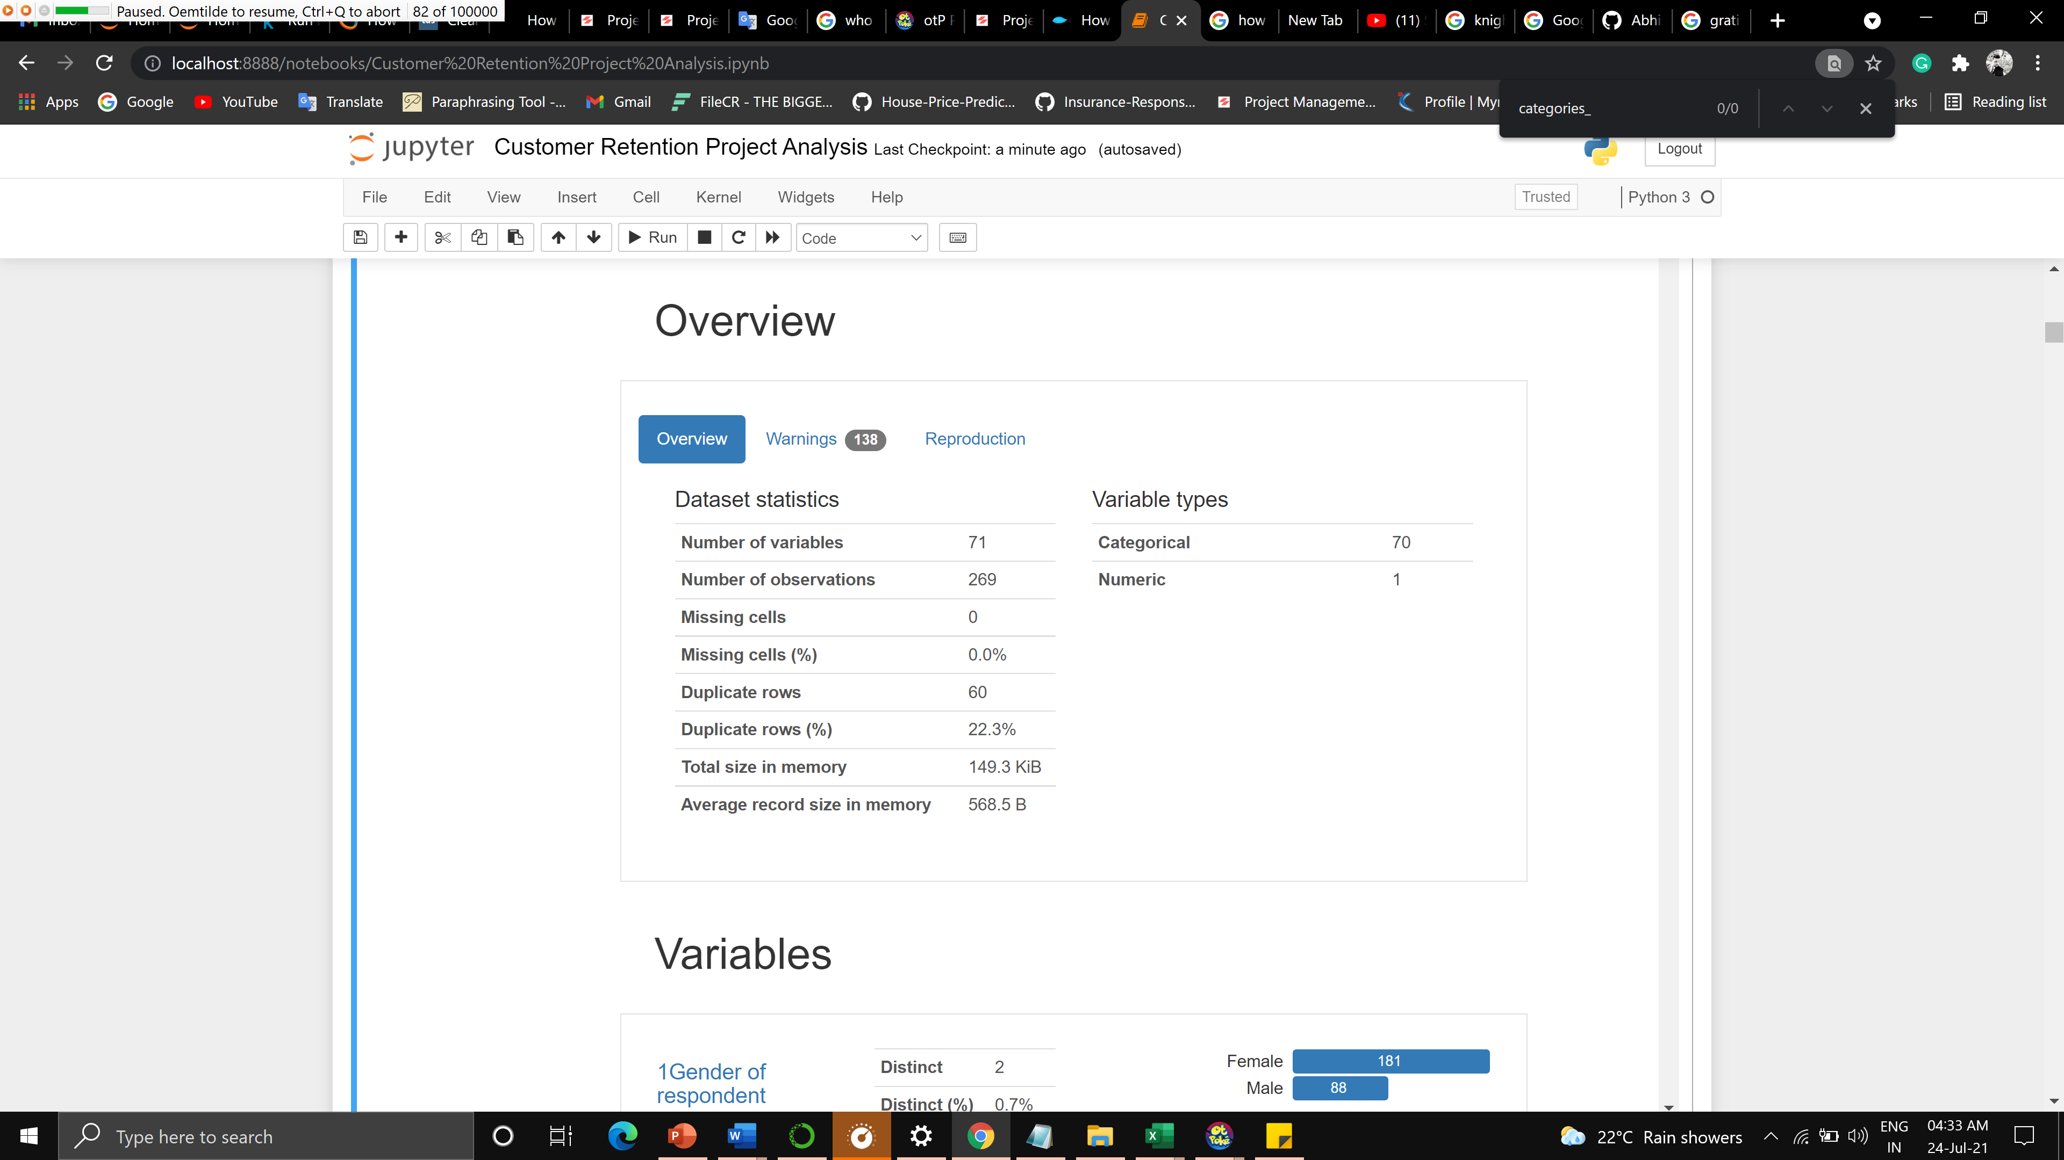

Slide 6
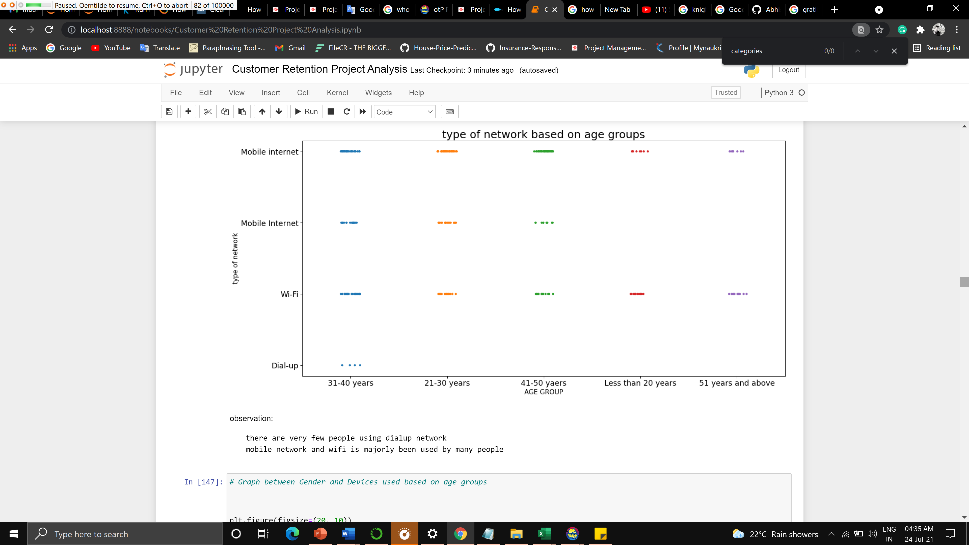

Slide 8
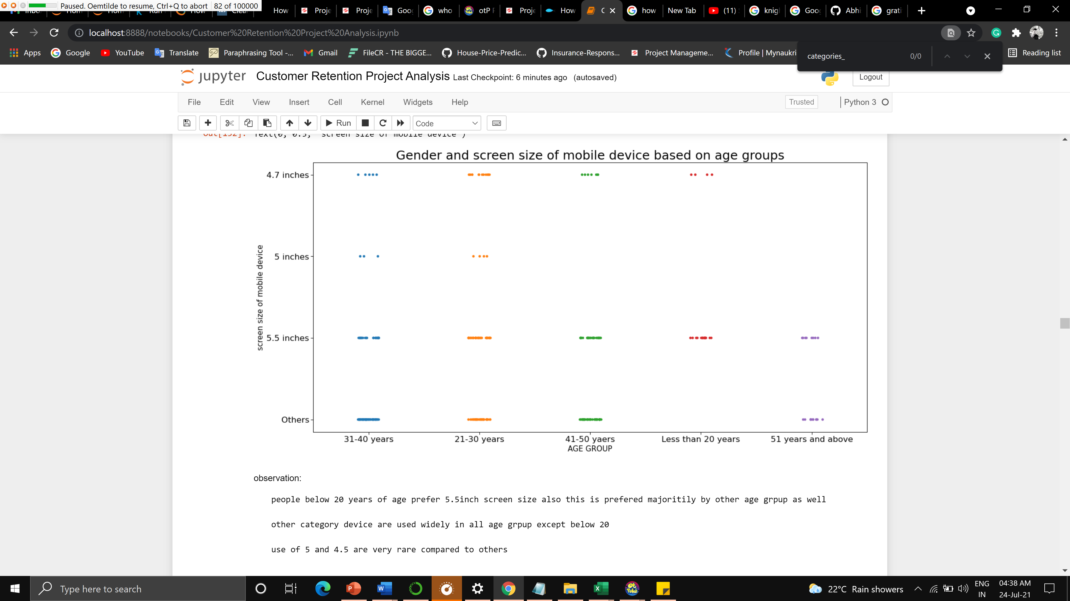

Slide 9
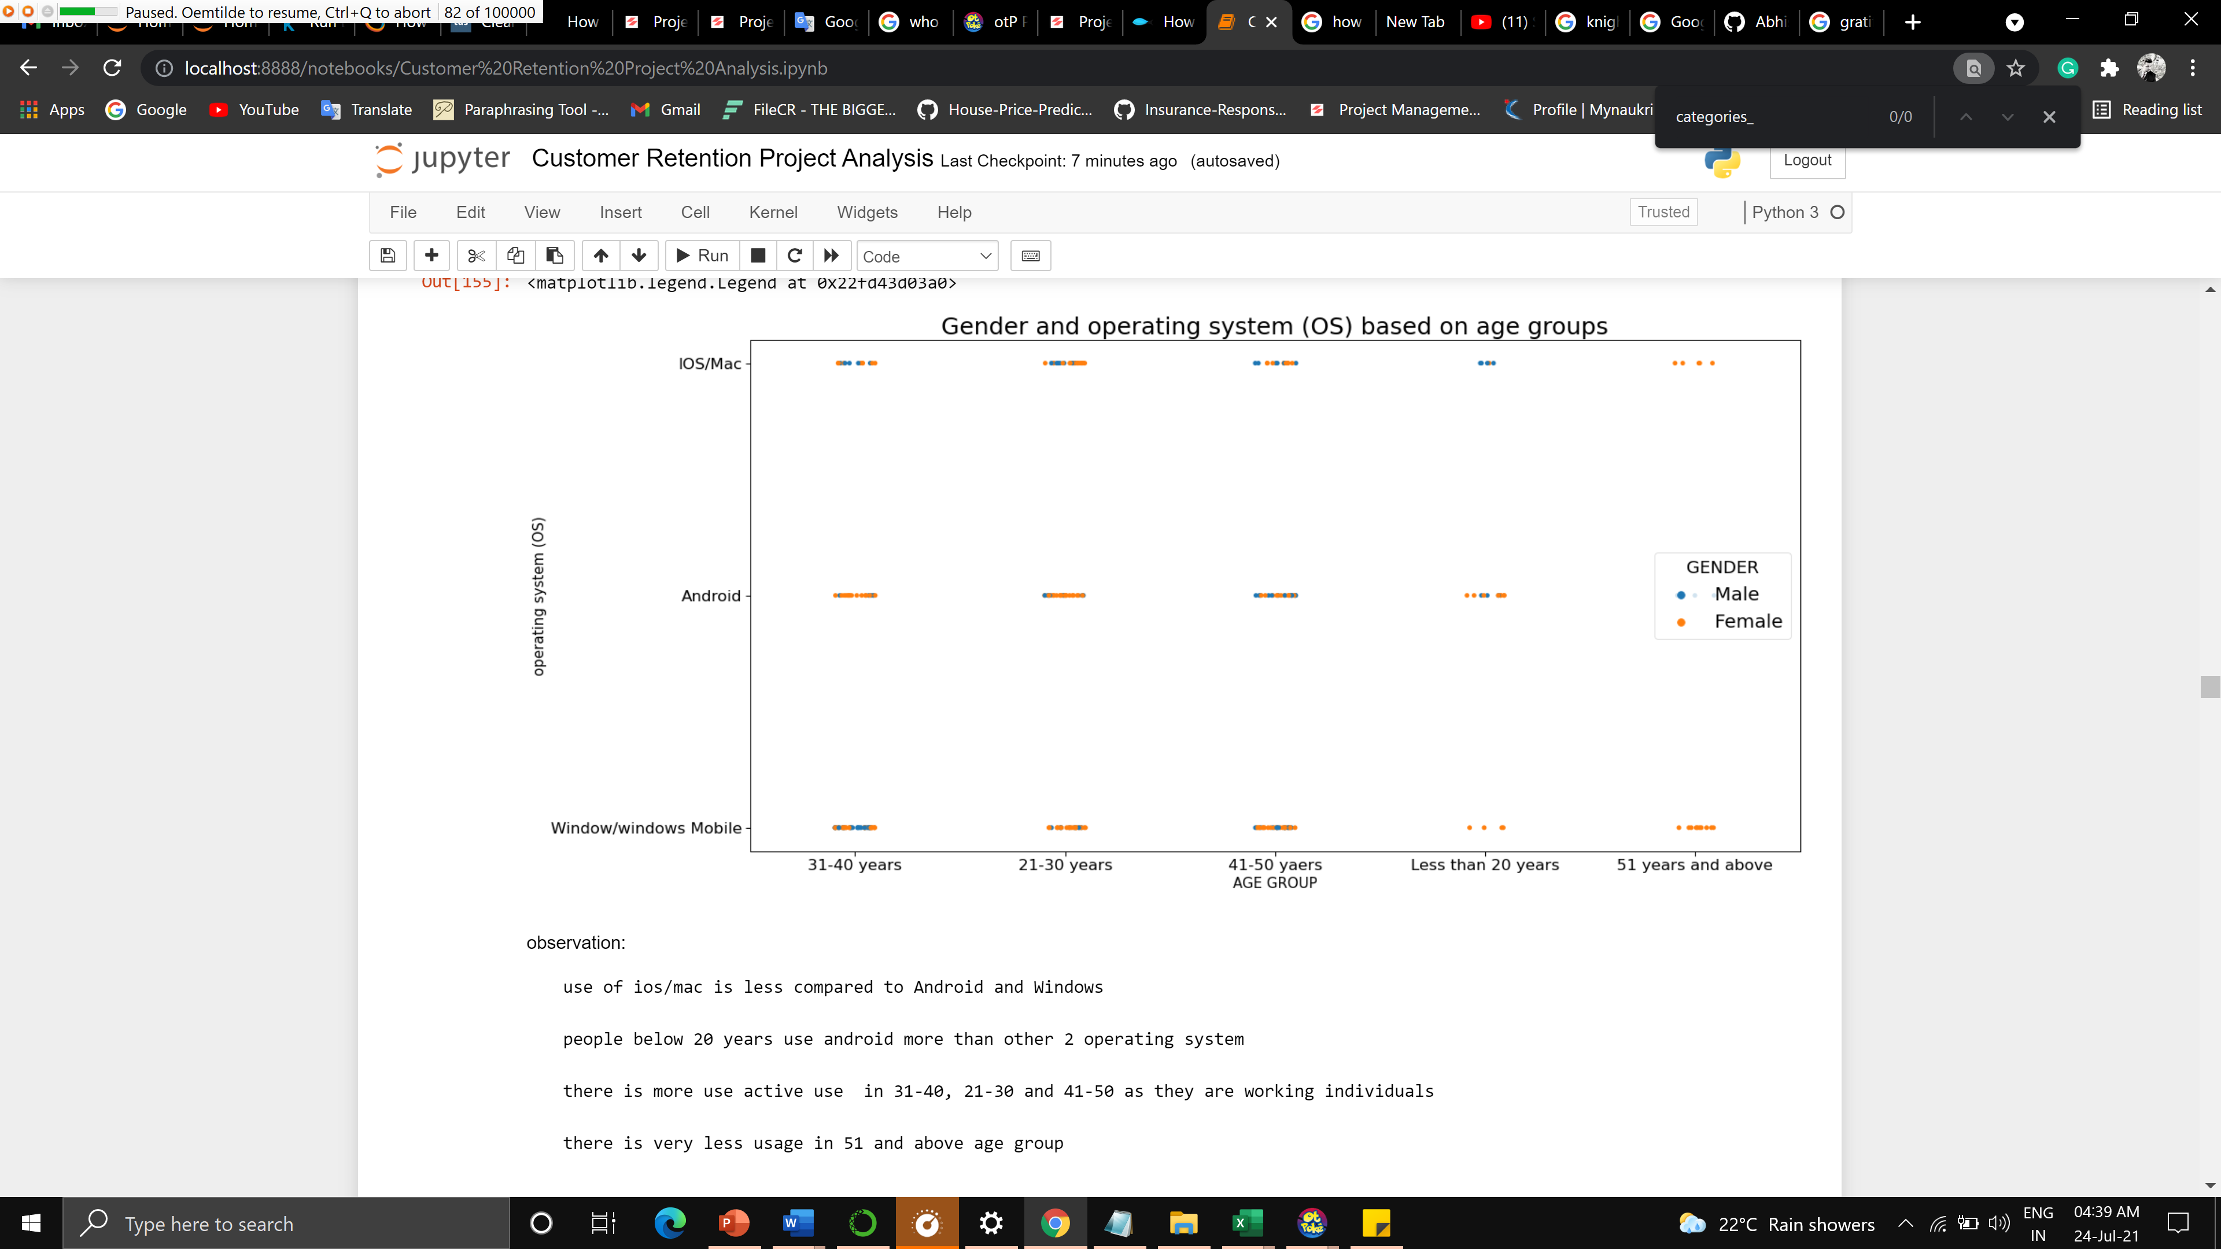

Slide 10
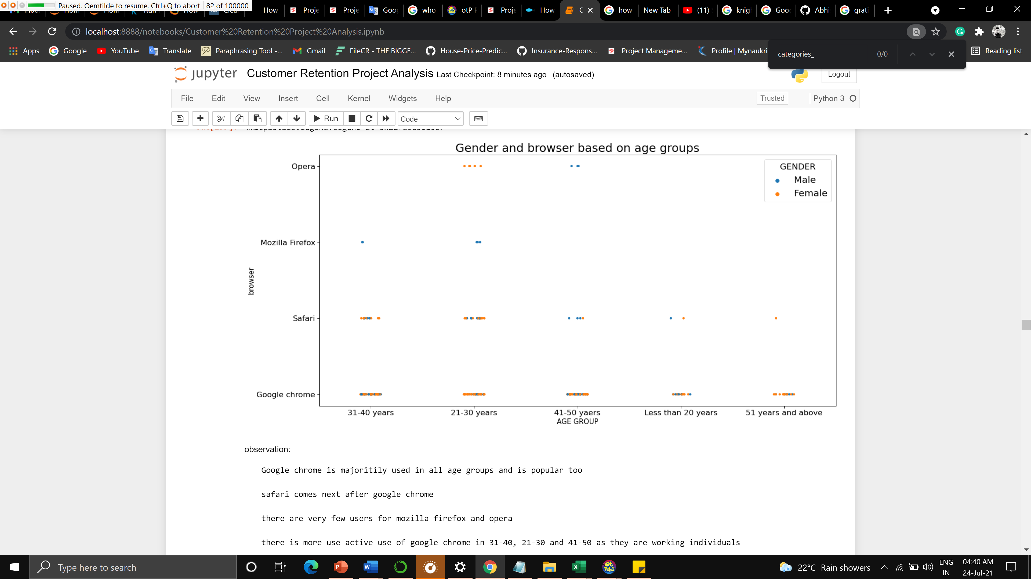

Slide 11
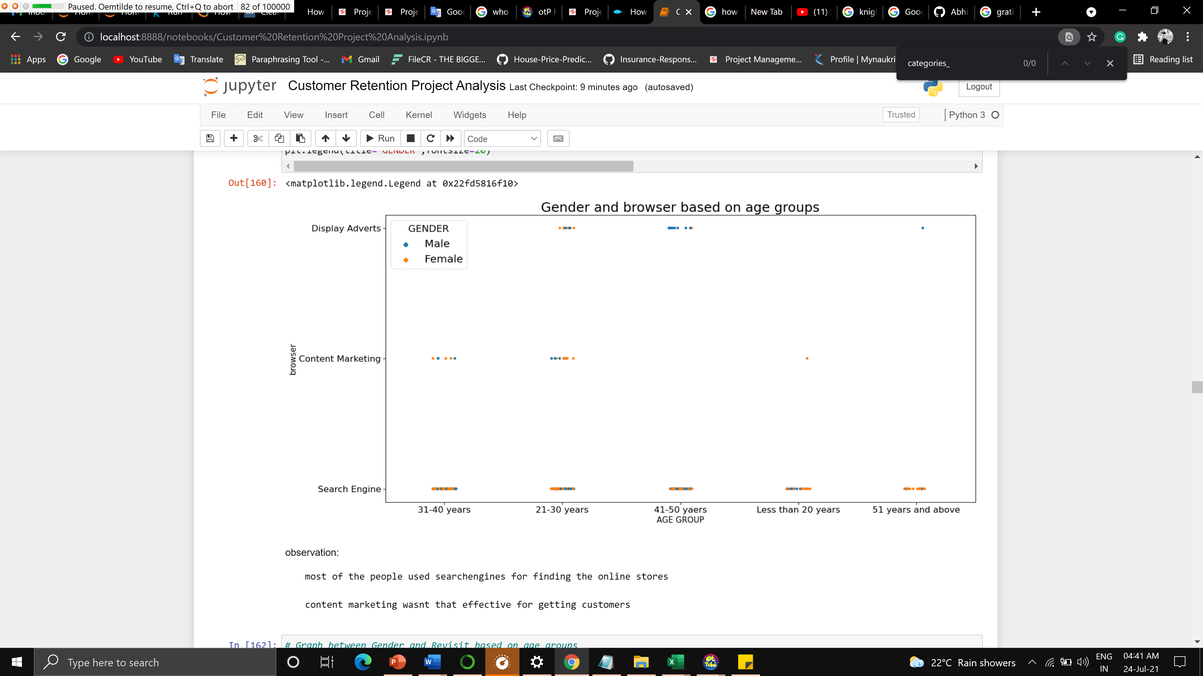

Slide 12
Conclusion
Key Findings and Conclusions of the Study
More number of people are ordering less than 10 times in an year which includes males and females of all age groups
Very few people are ordering more than 42 times in a year the participated age group is 41-50 and less than 20 years
The age group of 31-40, 2-30 and 41-50 have been actively ordering.
A majority of females have been ordering from Bangalore, solan, gaziabad and Greater Noida
Majority of males have been ordering from Delhi , Noida, bulandshahr

Slide 13
Conclusion
There is an active participation of females majoritily form all age groups
the males from 31-40 and 41-50 have been more actively ordering
There are very few people using dialup network
Mobile network and wifi is majorly been used by many people
Tablet is rarely used by ant individual
Individuals less than 20 years of age use smartphones
Smartphones and laptops are used by the majority of people
Use of desktop is very less compared to laptop and smartphones
People below 20 years of age prefer 5.5inch screen size also this is prefered majority by another age group as well

Slide 14
Conclusion
Other category devices are used widely in all age groups except below 20
Use of 5 and 4.5 are very rare compared to others
Use of ios/mac is less compared to Android and Windows
People below 20 years use android more than the other 2 operating system
There is more use active use in 31-40, 21-30 and 41-50 as they are working individuals
There is very little usage in 51 and above age group
Google chrome is majorly used in all age groups and is popular too
Safari comes next after google chrome
There are very few users for Mozilla firefox and opera
There is more use active use of google chrome in 31-40, 21-30 and 41-50 as they are working individuals
Most of the people use search engines for finding the online stores

Slide 15
Conclusion
Content marketing wasn't that effective for getting customers
Email and social media aren't effective to get people on the site as compared to direct URL, application and search engine
The majority of females use an application to access these sites
Direct URL is been used by all age groups people
There are the majority of people from 31-40, 21-30,41-50 who spend more than 6 minutes
Majority of females spend more than 11 minutes and 15 minutes on these sites
The age group less than 20 and more than 51 spend less time compared to others
Majority of people prefer credit debit cards and cash on delivery
E-wallets are preferred by 31-40 and 41-50 compared to other age groups
The majority of females can be seen abandoning the bag in all age groups

Slide 16
Conclusion
Majority od people in all age groups sometimes abondon the bag
A change on price, promocode not applicable and better alternative are major reason for the people to abondon the bag
Majority of people expect websiste to be easy to read and understand, website with these ease are much used by these individuals
Many of people consider Information on similar product to the one highlighted is important for product comparison can be an inportant factor to gain peoples interest on the website and very few doesn't find any difference in it.
Complete information on listed seller and product being offered can be an important factor to gain peoples interest on the website and very few don't find any difference in it.
Many people prefer All relevant information on listed products must be stated clearly

Slide 17
Conclusion
Ease of navigation in the website is highly preferred by all individuals from different age groups except few
Loading and processing speed highly preferred by all individuals of different ages, especially people with high-end devices and network services or someone looking for some sale etc
User-friendly Interface of the website highly preferred by all individuals from different ages, not all people are good enough to understand complex UI design websites with these simple UI can get more customers
Majority of people prefer most commonly used payment methods as it is available to the major number of people
The website must keep the words and deliver on time majority of the people expect this and is an important factor for business growth too

Slide 18
Conclusion
the Empathy (readiness to assist with queries) towards the customers is an important factor that attracts the majority of customers
Nowadays websites hold many critical data of customers from their card details to their mobile and address, majority of people consider privacy as an important factor for using a particular website
Many customers face issues, and they prefer to talk directly to the service desk by different means, in this case, a wide number of communication channels is what builds customers trust in the website
Some people love shopping to gain some discount or other benefits, for the majority of people this is a part that can grab their attention towards the website
Many people, the majority women get a feeling of enjoyment and satisfaction they feel happy when they buy stuff online
Majority of people prefer Shopping online in an convenient way and flexible way
The majority of people feel secure to shop online if there is a Return and replacement policy of the e-tailer
Many people like to gain access to loyalty programs is a benefit of shopping online it is like a cherry on the cake for them

Slide 19
Conclusion
Many people realistic information about the product this builds trust for the website
Better the website/application more and more customer perfer to use it
A wide variety of products helps gaining more customers to use the website
Many people consider online shopping as an adventure, for others its normal to shop but few people get a feeling of excitement which is a good sign for online retailers
Many people tend to post images of their shopping and consider it to raise their social status
Many people feel the Shopping on the website helps them fulfil certain roles which are a plus point for the online retailers
Pricing plays an important role for gaining customer, they should the money the spent is worth every penny.

